Slide 1
Module 3
DATA LINK LAYER

Slide 2
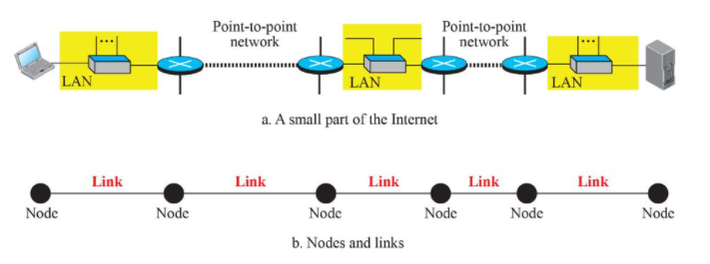
Node to node Communication
Provides services to the network layer
Receives services from the physical layer

Slide 3
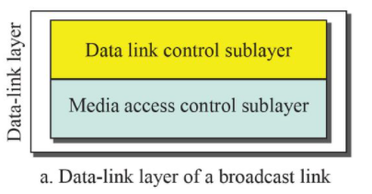
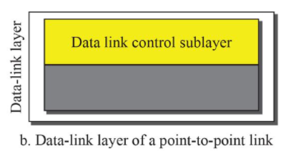
Point to point / Broadcast link

Slide 4
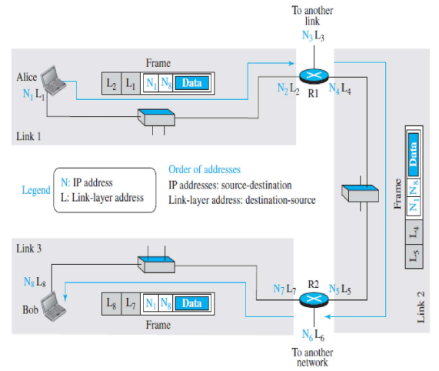
LINK-LAYER ADDRESSING
Physical address/ MAC address

Slide 5
ERROR DETECTION AND CORRECTION
Data can be corrupted during transmission.
Some applications require that errors be detected and corrected

Slide 6

Single-bit error
In a single-bit error, only 1 bit in the data unit has changed.

Slide 7

Burst error of length 8
A burst error means that 2 or more bits in the data unit have changed.

Slide 8

The structure of encoder and decoder
To detect or correct errors, we need to send extra (redundant) bits with data.

Slide 9
BLOCK CODING
Divide our message into blocks, each of k bits, called datawords.
Add r redundant bits to each block to make the length n = k + r.
The resulting n-bit blocks are called codewords.
Error Detection
Error Correction
Hamming Distance
Minimum Hamming Distance

Slide 10

Datawords and codewords in block coding
Eg: 4B/5B block coding

Slide 11
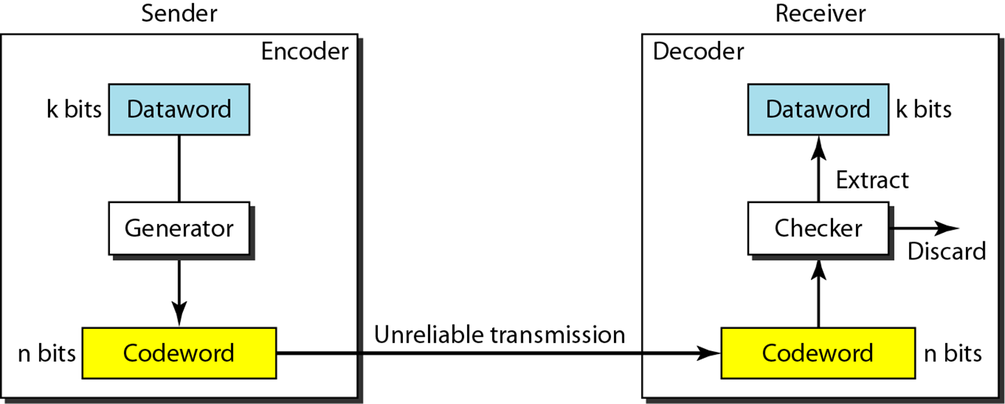
Error Detection
Enough redundancy is added to detect an error.
The receiver knows an error occurred but does not know which bit(s) is(are) in error.
Has less overhead than error correction.

Slide 12

Example
data
The receiver receives 011. It is a valid codeword. The
receiver extracts the dataword 01 from it.
2. The codeword is corrupted during transmission, and
111 is received. This is not a valid codeword and is
discarded.
3. The codeword is corrupted during transmission, and
000 is received. This is a valid codeword. The receiver
incorrectly extracts the dataword 00. Two corrupted
bits have made the error undetectable.

Slide 13
An error-detecting code can detect
only the types of errors for which it is designed; other types of errors may remain undetected.
Forward Error Correction / Retransmission

Slide 14

Structure of encoder and decoder in error correction

Slide 15

Example
Add 3 redundant bits to the 2-bit dataword to make 5-bit codewords
dataword → 01.
Sender ->01011. Received→ 01001
Assume 1 bit corruption
Minimum Hamming distance

Slide 16

HAMMING DISTANCE
The Hamming distance between two words is the number of differences between corresponding bits.
Hamming distance, d(000, 011) = 2
Minimum Hamming distance of the coding scheme
dmin = 2.
detection of only a single error

Slide 17
Example
d_{min} = 3.
code can detect up to two errors
To guarantee the detection of up to s errors in all cases, the minimum Hamming distance in a block code must be d_{min} = s + 1.

Slide 18

Geometric concept for finding d_{min} in error detection

Slide 19

Geometric concept for finding d_{min} in error correction
To guarantee correction of up to t errors in all cases, the minimum Hamming distance in a block code must be d_{min} = 2t + 1.

Slide 20
10-3 LINEAR BLOCK CODES
A linear block code is a code in which the exclusive OR (addition modulo-2) of two valid codewords creates another valid codeword.
Minimum Distance for Linear Block Codes
Some Linear Block Codes

Slide 21
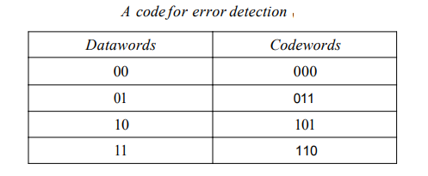
A simple parity-check code is a
single-bit error-detecting code in which
n = k + 1 with d_{min} = 2.
Even parity (ensures that a codeword has an even number of 1’s) and odd parity (ensures that there are an odd number of 1’s in the codeword)

Slide 22

Encoder and decoder for simple parity-check code
10.

Slide 23
Example 10.12
Sender sends the dataword 1011, the codeword 10111
1. No error occurs; the received codeword is 10111. The syndrome is 0. The dataword 1011 is created.
2. One single-bit error changes a₁ . The received
codeword is 10011. The syndrome is 1. No dataword is created.
3. One single-bit error changes r₀ . The received codeword is 10110. The syndrome is 1. No dataword is created.

Slide 24
4. An error changes r₀ and a second error changes a₃ . The received codeword is 00110. The syndrome is 0.The dataword 0011 is created at the receiver.
5. Three bits—a₃, a₂, and a₁—are changed by errors. The received codeword is 01011. The syndrome is 1.
The dataword is not created. This shows that the simple parity check, guaranteed to detect one single error, can also find any odd number of errors.

Slide 25

Note
A simple parity-check code can detect an odd number of errors.

Slide 26

Figure 10.11 Two-dimensional parity-check code
10.

Slide 27

Figure 10.11 Two-dimensional parity-check code

Slide 28

Figure 10.11 Two-dimensional parity-check code
10.

Slide 29
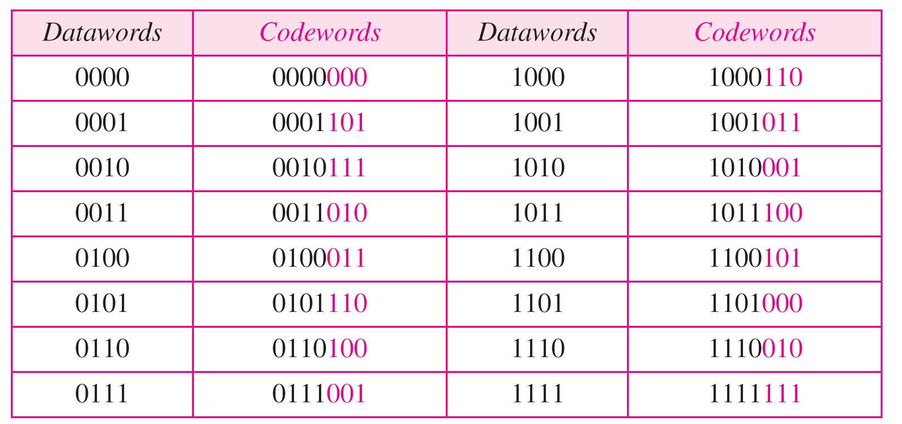
Hamming code C(7, 4) - n=7, k = 4

Slide 30
Calculating the parity bits at the transmitter
:
Modulo 2 arithmetic:
r0 = a2 + a1 + a0
r1 = a3 + a2 + a1
r2 = a1 + a0 + a3
Calculating the syndrome at the receiver:
s0 = b2 + b1 + b0
s1 = b3 + b2 + b1
s2 = b1 + b0 + b3

Slide 31


The structure of the encoder and decoder for a Hamming code
Logical decision made by the correction logic analyzer

Slide 32
Example
Let us trace the path of three datawords from the sender to the destination:
1. The dataword 0100 ->codeword 0100011.The codeword 0100011 is received. The syndrome is 000, the final dataword is 0100.
2. The dataword 0111 becomes the codeword 0111001.The received codeword is: 0011001. The syndrome is 011. After flipping b₂ (changing the 1 to 0), the final dataword is 0111.
3. The dataword 1101 becomes the codeword 1101000.The syndrome is 101. After flipping b₀, we get 0000,the wrong dataword. This shows that our code cannot correct two errors.

Slide 33
Example
We need a dataword of at least 7 bits. Calculate values of k and n that satisfy this requirement.
Solution
We need to make k = n − m greater than or equal to 7, or 2m − 1 − m ≥ 7.
1. If we set m = 3, the result is n = 2³ − 1=7 and k = 7 − 3,
or 4, which is < 7.
2. If we set m = 4, then n = 2⁴ − 1 = 15 and k = 15 − 4 =
11, which satisfies the condition k>7. So the code is
C(15, 11)

Slide 34
Burst Errors
Burst errors are very common, in wireless environments where a fade will affect a group of bits in transit.
The length of the burst is dependent on the duration of the fade.
One way to counter burst errors, is to break up a transmission into shorter words and create a block (one word per row), then have a parity check per word.
The words are then sent column by column. When a burst error occurs, it will affect 1 bit in several words as the transmission is read back into the block format and each word is checked individually.

Slide 35

Burst error correction using Hamming code

Slide 36
CYCLIC CODES
Cyclic codes are special linear block codes with one extra property.
In a cyclic code, if a codeword is cyclically shifted (rotated), the result is another codeword.

Slide 37

A CRC code with C(7, 4)

Slide 38

CRC encoder and decoder

Slide 39

Division in CRC encoder

Slide 40

Division in the CRC decoder for two cases

Slide 41
Using Polynomials
We can use a polynomial to represent a binary word.
Each bit from right to left is mapped onto a power term.
The rightmost bit represents the “0” power term. The bit next to it the “1” power term, etc.
If the bit is of value zero, the power term is deleted from the expression.

Slide 42

A polynomial to represent a binary word

Slide 43

CRC division using polynomials

Slide 44
The divisor in a cyclic code is normally called the generator polynomial
or simply the generator.

Slide 45
In a cyclic code,
If s(x) ≠ 0, one or more bits is corrupted.
If s(x) = 0, either
a. No bit is corrupted. or
b. Some bits are corrupted, but the
decoder failed to detect them.

Slide 46
Note
In a cyclic code, those e(x) errors that are divisible by g(x) are not caught.
Received codeword =c(x) + e(x)
(c(x) + e(x))/g(x) = c(x)/g(x) + e(x)/gx
The first part is by definition divisible the second part will determine the error.
If “0” conclusion -> no error occurred. Note: that could mean that an error went undetected.

Slide 47
Note
If the generator has more than one term and the coefficient of x⁰ is 1,
all single errors can be caught.

Slide 48
Example 10.15
Which of the following g(x) values guarantees that a single-bit error is caught? For each case, what is the error that cannot be caught?
a. x + 1 b. x³ c. 1
Solution
a. No x^{i} can be divisible by x + 1. Any single-bit error can
be caught.
b. If i is equal to or greater than 3, x^{i} is divisible by g(x).
All single-bit errors in positions 1 to 3 are caught.
c. All values of i make x^{i} divisible by g(x). No single-bit
error can be caught. This g(x) is useless.

Slide 49

Representation of two isolated single-bit errors using polynomials
If a generator (g(x)) cannot divide x^{t} + 1
(t between 0 and n – 1),
then all isolated double errors
can be detected.

Slide 50
Example 10.16
Find the status of the following generators related to two isolated, single-bit errors.
a. x + 1 b. x⁴ + 1 c. x⁷ + x⁶ + 1 d. x¹⁵ + x¹⁴ + 1
Solution
a. This is a very poor choice for a generator. Any two
errors next to each other cannot be detected.
b. This generator cannot detect two errors that are four
positions apart.
c. This is a good choice for this purpose.
d. This polynomial cannot divide x^{t} + 1 if t is less than
32,768. A codeword with two isolated errors up to
32,768 bits apart can be detected by this generator.

Slide 51
Odd Number of Errors
A generator that contains a factor of
x + 1 can detect all odd-numbered errors.

Slide 52
❏ All burst errors with L ≤ r will be
detected.
❏ All burst errors with L = r + 1 will be
detected with probability 1 – (1/2)^{r–1}.
❏ All burst errors with L > r + 1 will be
detected with probability 1 – (1/2)^{r}.
L-1 = j-i

Slide 53
Example 10.17
Find the suitability of the following generators in relation to burst errors of different lengths.
a. x⁶ + 1 b. x¹⁸ + x⁷ + x + 1 c. x³² + x²³ + x⁷ + 1
Solution
a. This generator can detect all burst errors with a length
less than or equal to 6 bits; 3 out of 100 burst errors
with length 7 will slip by; 16 out of 1000 burst errors of
length 8 or more will slip by.

Slide 54
Note
A good polynomial generator needs to have the following characteristics:
1. It should have at least two terms.
2. The coefficient of the term x⁰ should
be 1.
3. It should not divide x^{t} + 1, for t
between 2 and n − 1.
4. It should have the factor x + 1.
10.

Slide 55
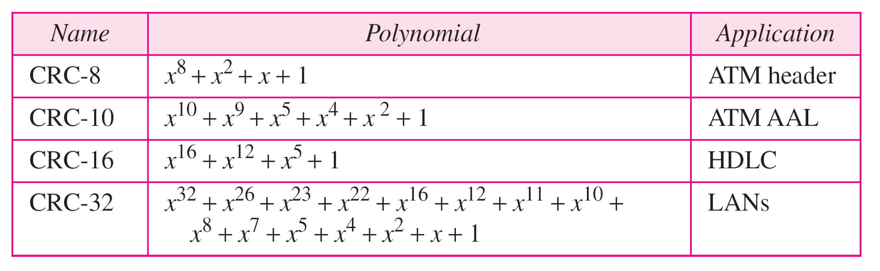
Table 10.7 Standard polynomials
10.

Slide 56
10-5 CHECKSUM
The checksum is used in the Internet by several protocols although not at the data link layer.

Slide 57
Example 10.18
Suppose our data is a list of five 4-bit numbers that we want to send to a destination.
In addition to sending these numbers, we send the sum of the numbers.
For example, if the set of numbers is (7, 11, 12, 0, 6), we send (7, 11, 12, 0, 6, 36), where 36 is the sum of the original numbers.
The receiver adds the five numbers and compares the result with the sum.
If the two are the same, the receiver assumes no error, accepts the five numbers, and discards the sum.
Otherwise, there is an error somewhere and the data are not accepted.

Slide 58
Example 10.19
We can make the job of the receiver easier if we send the negative (complement) of the sum, called the checksum.
In this case, we send (7, 11, 12, 0, 6, −36). The receiver can add all the numbers received (including the checksum).
If the result is 0, it assumes no error; otherwise, there is an error.

Slide 59

Figure 10.24 Example 10.22
10.

Slide 60
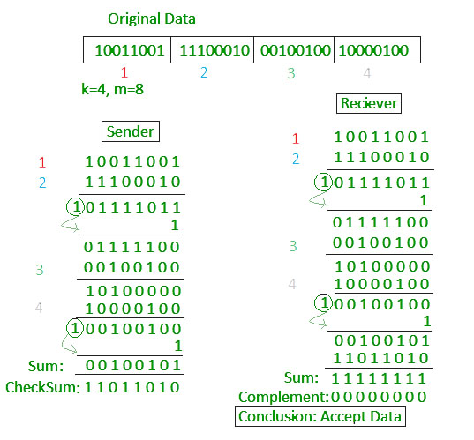

Slide 61
Note
Sender site:
1. The message is divided into 16-bit words.
2. The value of the checksum word is set to 0.
3. All words including the checksum are
added using one’s complement addition.
4. The sum is complemented and becomes the
checksum.
5. The checksum is sent with the data.
10.

Slide 62
Note
Receiver site:
1. The message (including checksum) is
divided into 16-bit words.
2. All words are added using one’s
complement addition.
3. The sum is complemented and becomes the
new checksum.
4. If the value of checksum is 0, the message
is accepted; otherwise, it is rejected.
10.

